Slide 1
Increasing the Visibility of
AI Digital Humanities Projects
2024 MLA Annual Convention
January 4th-7th 2024 Philadelphia, PA
https://github.com/jon-chun/mla-generative-ai
Jon Chun
Kenyon College

Slide 2
Overview
Introduction
Human-Centered AI
Research Methodology
Information Design & Editing

Slide 3

Introduction
DH@Kenyon

Slide 4

Integrated Program for Humane Studies (IPHS)

Slide 5
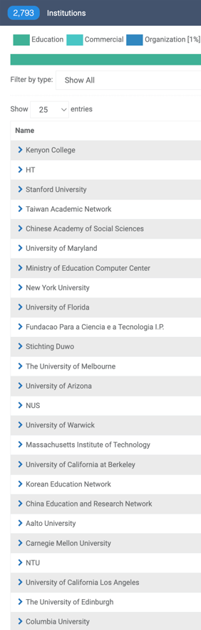
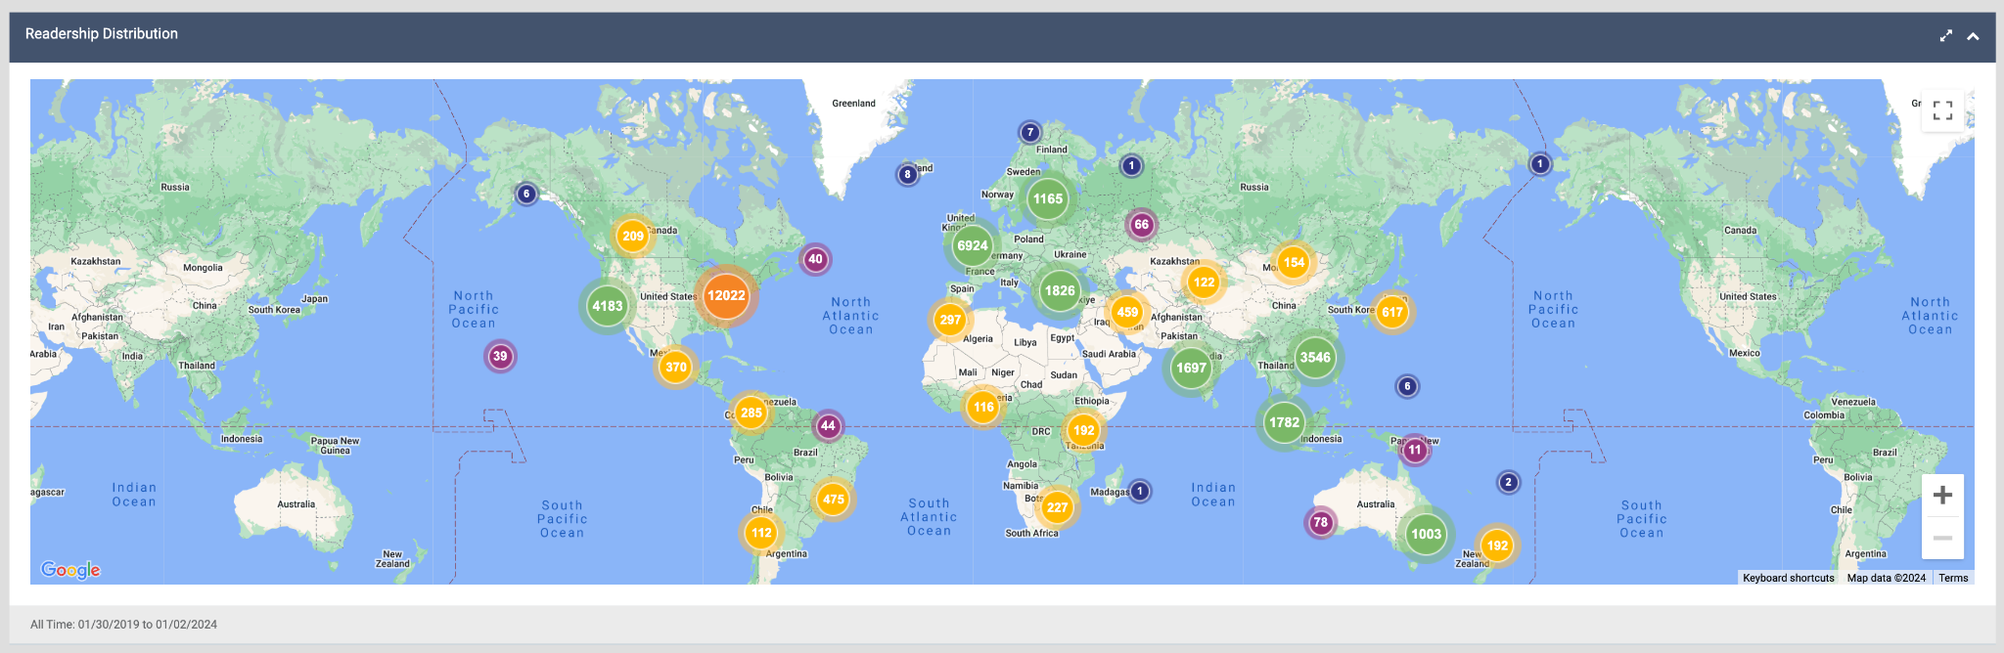
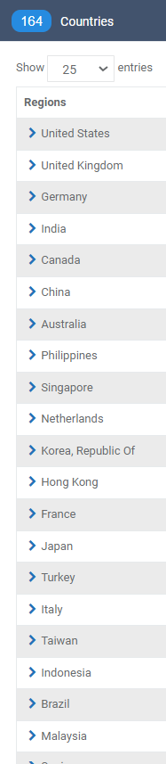
Data Analytics
Machine Learning
DNN
NLP
Multimodal Affective AI
LLM/LMM Generative AI
FATE/XAI
Open Source Models
Metrics and Benchmarks
Human-AI Alignment and AI Safety

Slide 6


Library & Information Systems
(LBIS)

Slide 7
Human-Centered AI

Slide 8
Kenyon Digital Humanities K{DH} Human-First AI Curriculum
Digital humanities at Kenyon encompasses a dual lens. We empower the next generation of thinkers with the conceptual framework underlying our Age of Information — from dataism and algorithmic thinking to synthetic biology and artificial intelligence. Our unique approach to computational thinking positions students to engage with the many practical, theoretical and ethical issues surrounding technological innovation and social change.
Digital humanities also explores the most recent computational approaches as a way to augment — rather than replace — more traditional humanist inquiry. Students imagine and pursue new avenues of research by identifying unexplored datasets of text, image and sound, while embracing new computational frameworks that are increasingly powerful and easy to use. We focus on finding interdisciplinary solutions to today's challenges.
Liberal Arts
Digital Humanities
Artificial Intelligence
Notes:
https://www.williams.edu/strategic-planning/strategic-plan-2021/
https://www.williams.edu/strategic-planning/files/2020/07/Data-Science-and-Digital-Humanities-FINAL.pdf

Slide 9
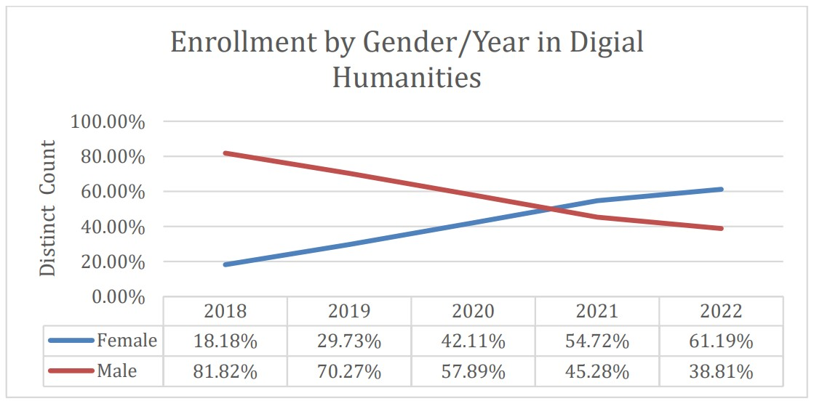
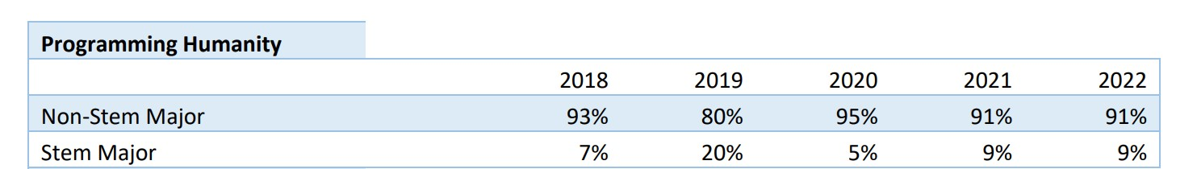
Non-STEM ~90%
Women 61%
Latine 11%
African-American 13%
We serve students who may otherwise feel alienated by traditional CS or AI programs

Slide 10
Goals
&
Outcomes
Intellectual Framework
Key Abstractions
Many Model Thinkers
Think Critically & Thrive
Synthesize/Applied Humanities
Find Stories in Data & Visualize
Testable Theories
Operationalize & Effect Change
Grad School / Opportunities

Slide 11
Research
Methodology

Slide 12
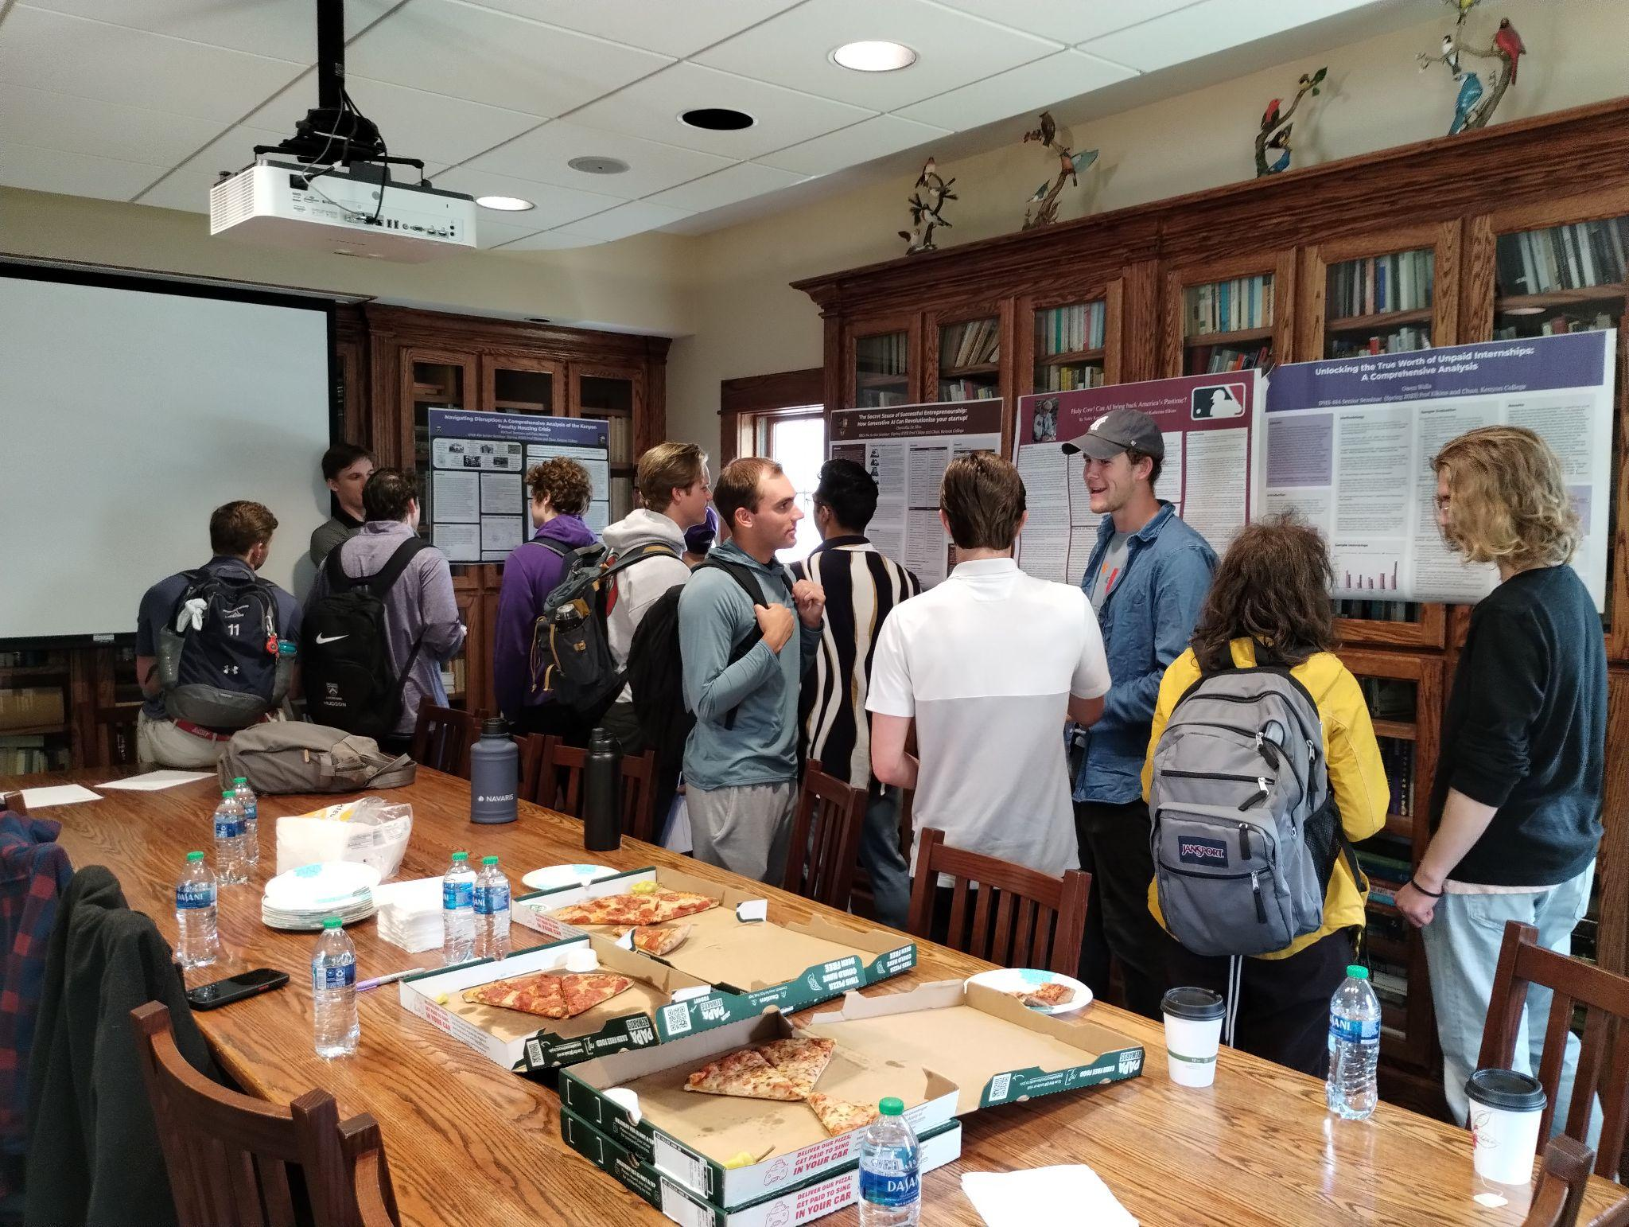
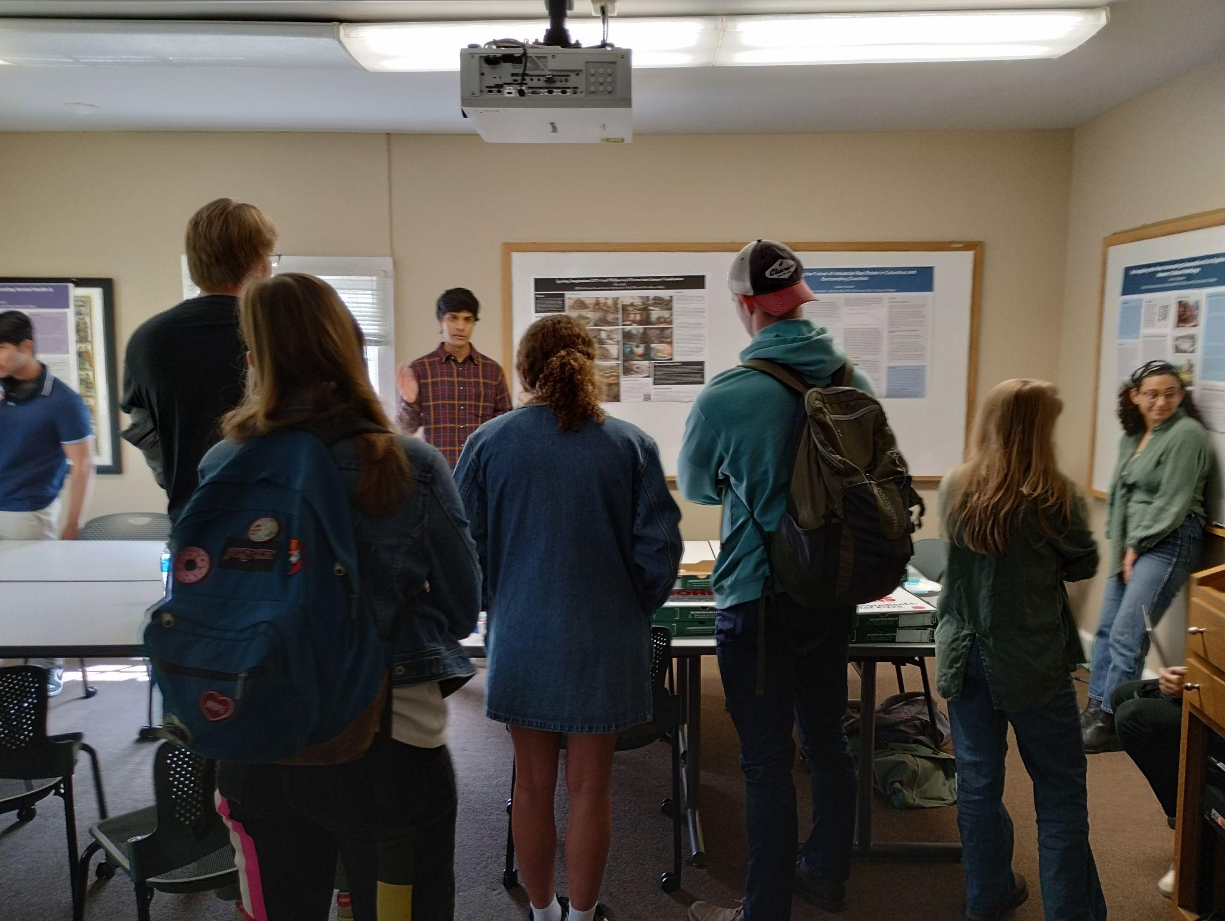
Poster Sessions

Slide 13
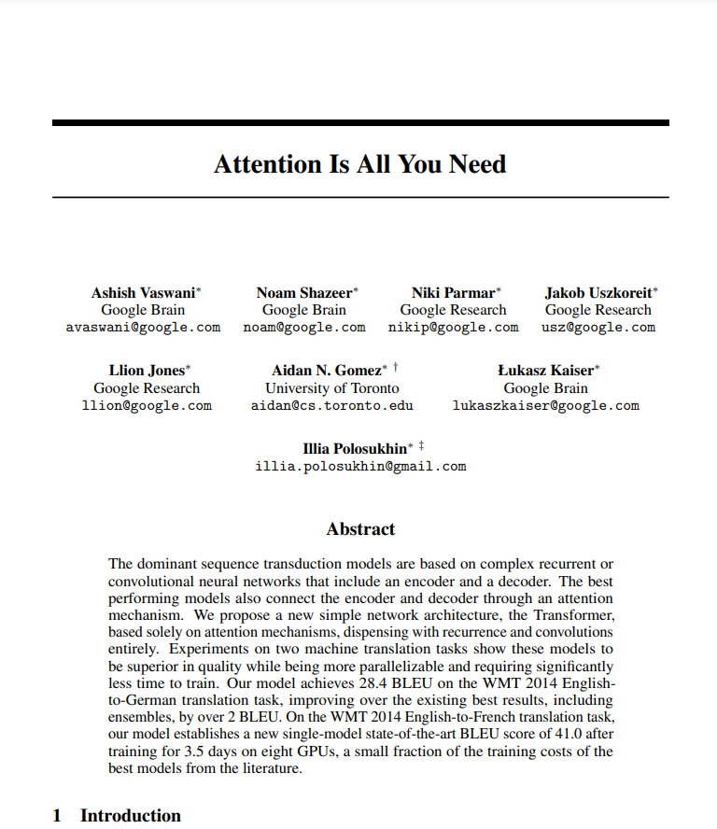
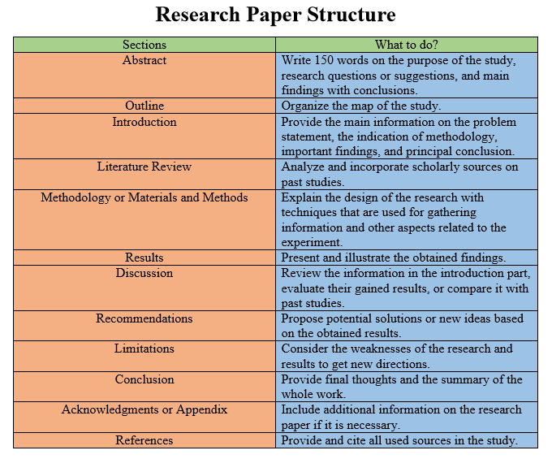
AI Research Paper
https://wr1ter.com/research-paper
Notes:
https://wr1ter.com/research-paper

Slide 14
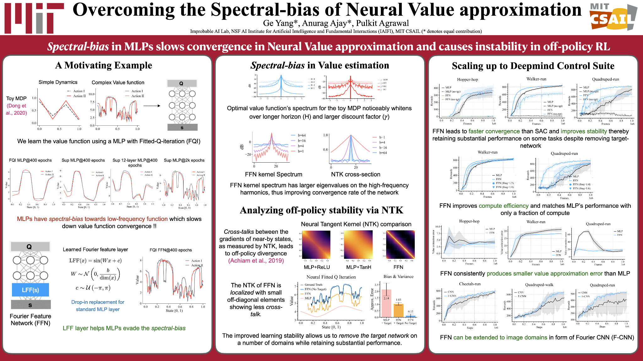
AI Research Poster
https://cap.csail.mit.edu/student-poster-presentations
Notes:
https://cap.csail.mit.edu/student-poster-presentations

Slide 15
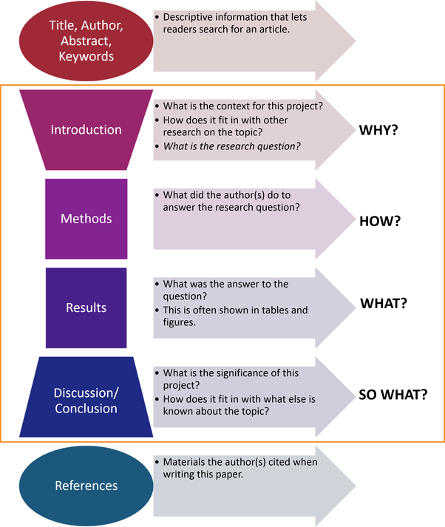
Distilling
Papers
To
Posters
https://www.quora.com/What-is-the-structure-of-research-papers-article
Notes:
https://www.quora.com/What-is-the-structure-of-research-papers-article

Slide 16
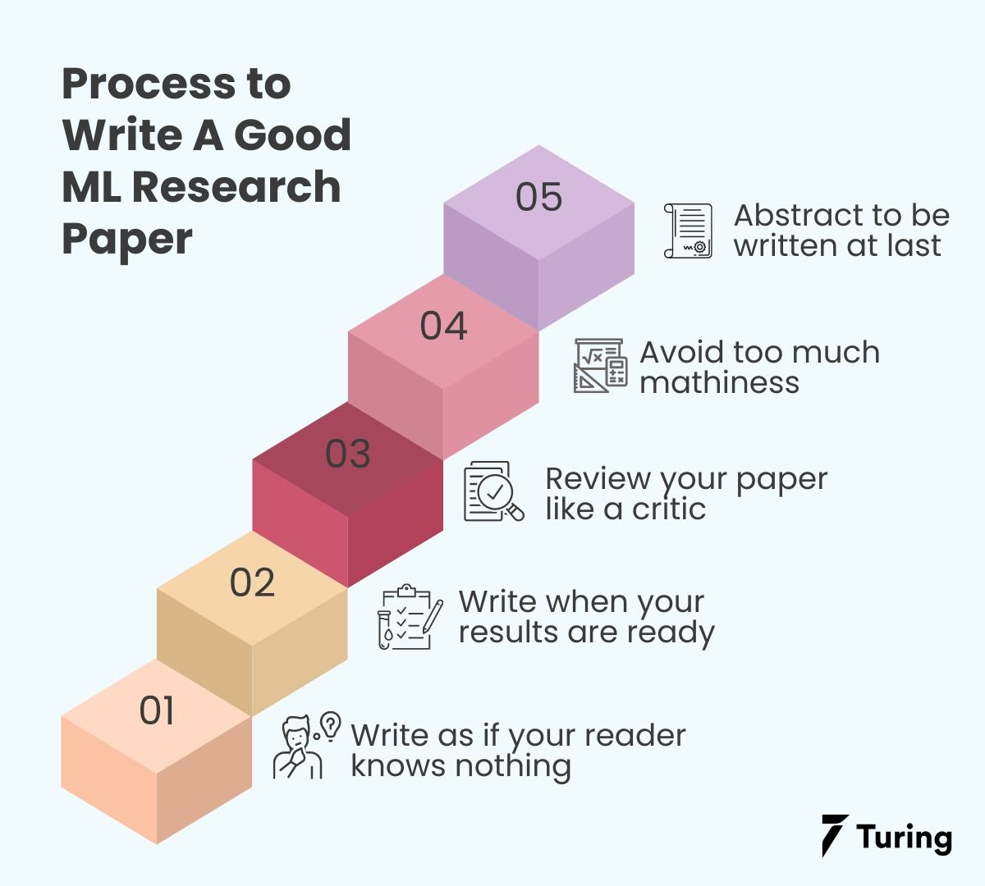
A
New
Writing
Process
https://www.turing.com/kb/how-to-write-research-paper-in-machine-learning-area
Notes:
https://www.turing.com/kb/how-to-write-research-paper-in-machine-learning-area

Slide 17
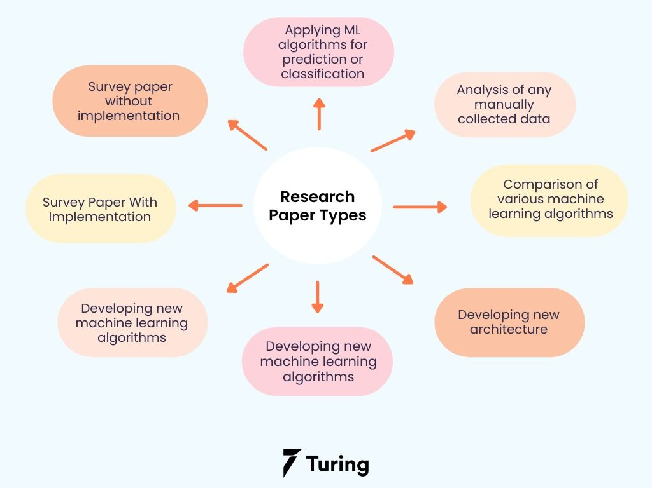
Topics
&
Genres
https://www.turing.com/kb/how-to-write-research-paper-in-machine-learning-area
Notes:
https://www.turing.com/kb/how-to-write-research-paper-in-machine-learning-area

Slide 18
Information Architecture
&
Editing

Slide 19
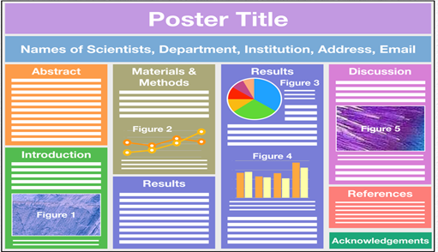
https://mindthegraph.com/blog/scientific-posters-everything-you-need-to-know/
Notes:
https://mindthegraph.com/blog/scientific-posters-everything-you-need-to-know/

Slide 20
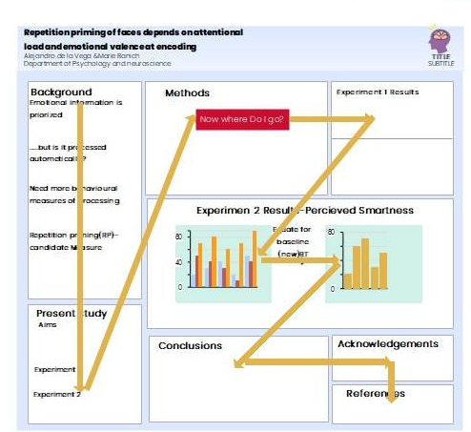
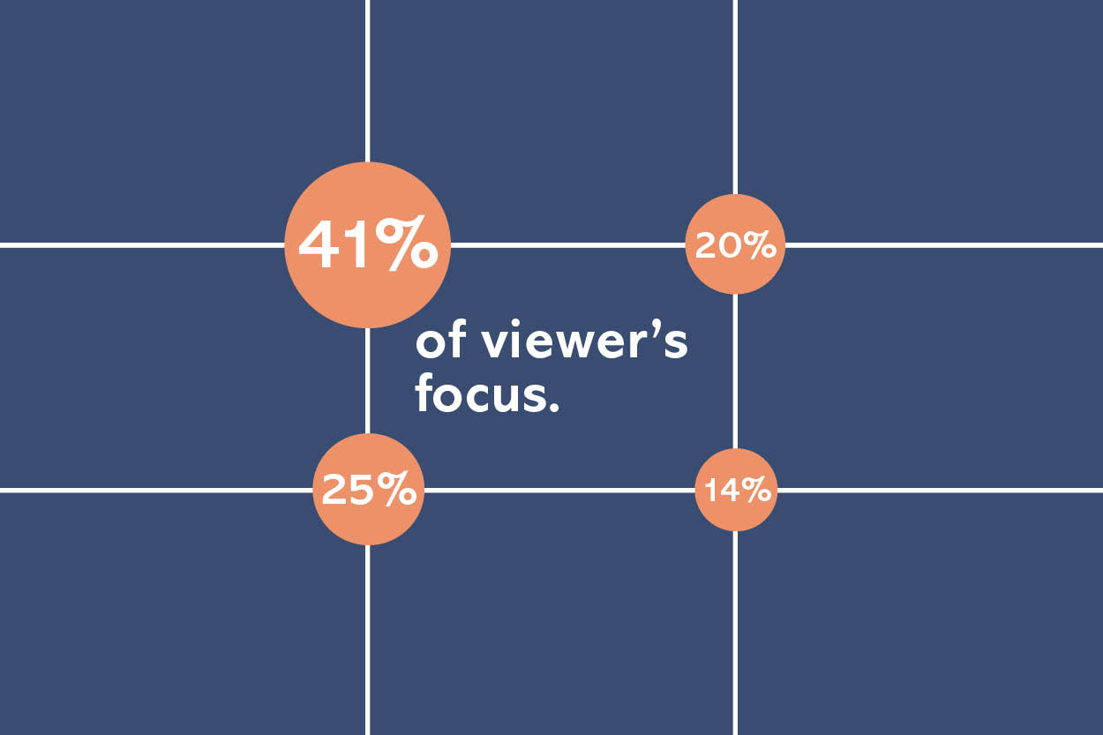
Psychology & Information Architecture
https://www.edrawmax.com/article/what-is-research-poster.html
Notes:
https://www.edrawmax.com/article/what-is-research-poster.html

Slide 21
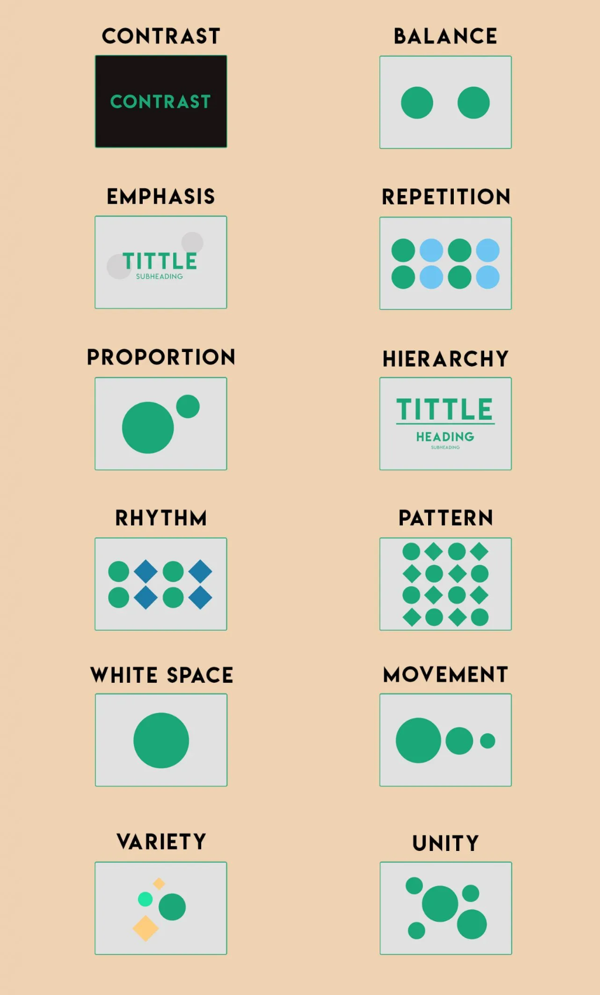
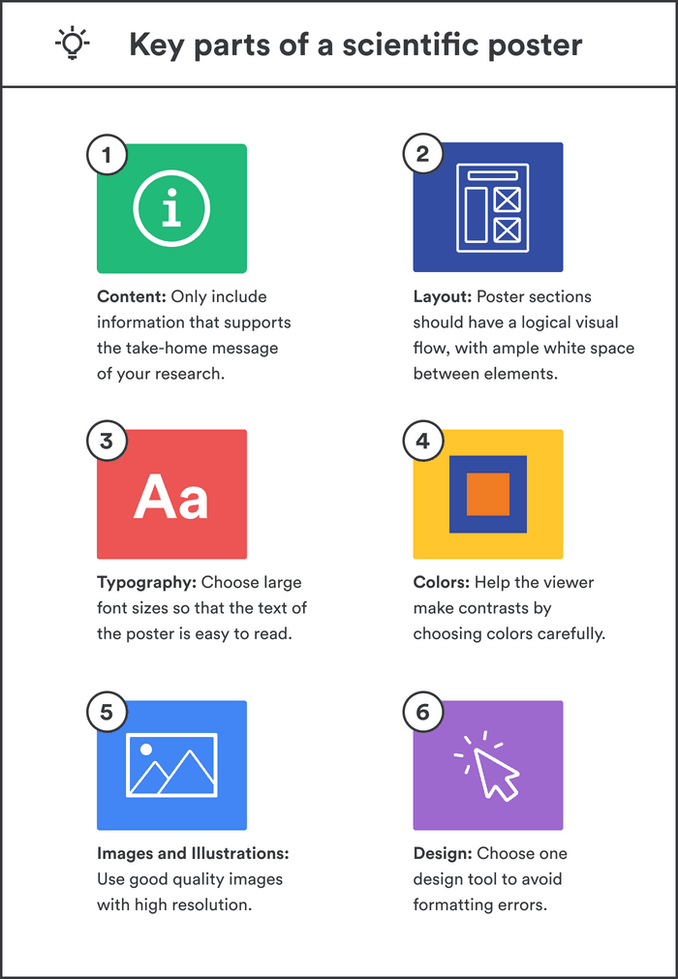
Graphic Design Principles
https://paperpile.com/g/scientific-poster/
https://www.zekagraphic.com/12-principles-of-graphic-design/
Notes:
https://paperpile.com/g/scientific-poster/
https://www.zekagraphic.com/12-principles-of-graphic-design/

Slide 22
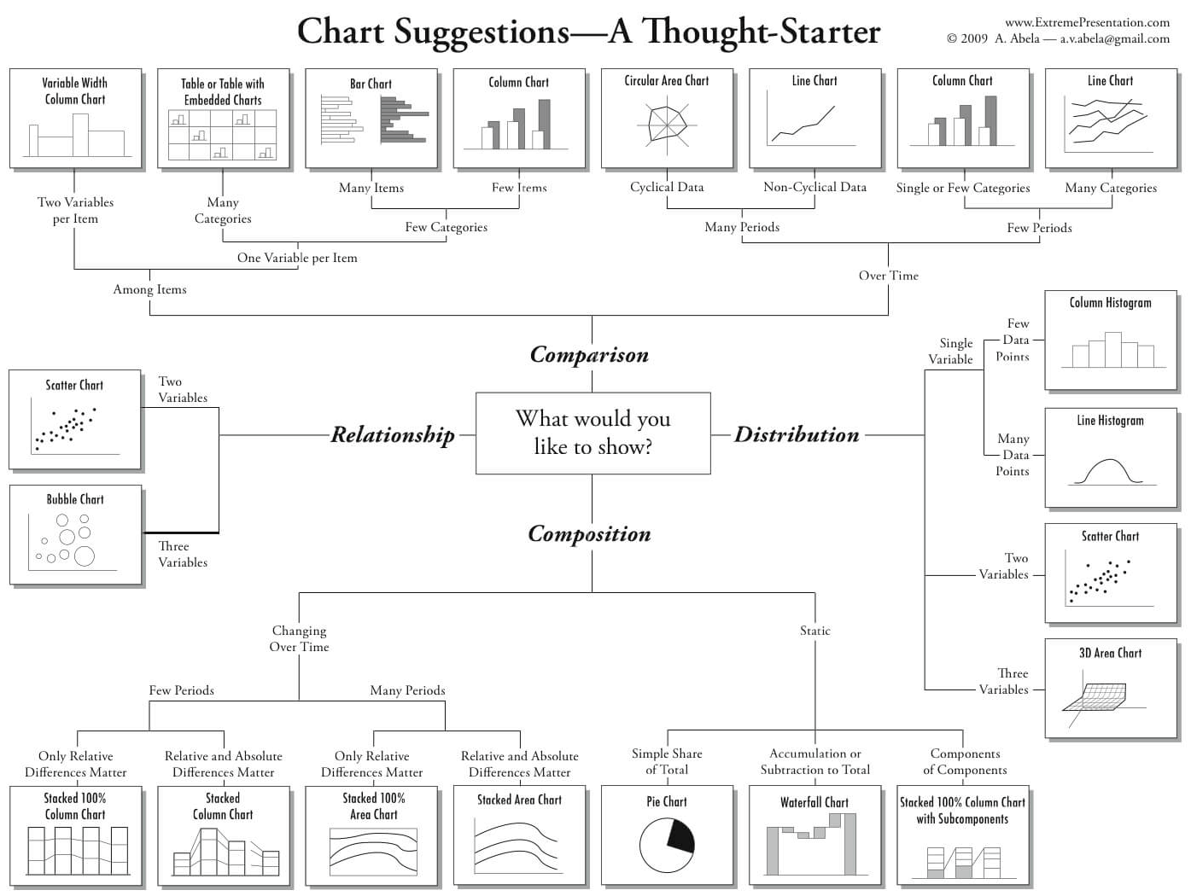
DataViz
Best
Practices
https://eazybi.com/blog/data-visualization-and-chart-types
Notes:
https://eazybi.com/blog/data-visualization-and-chart-types

Slide 23
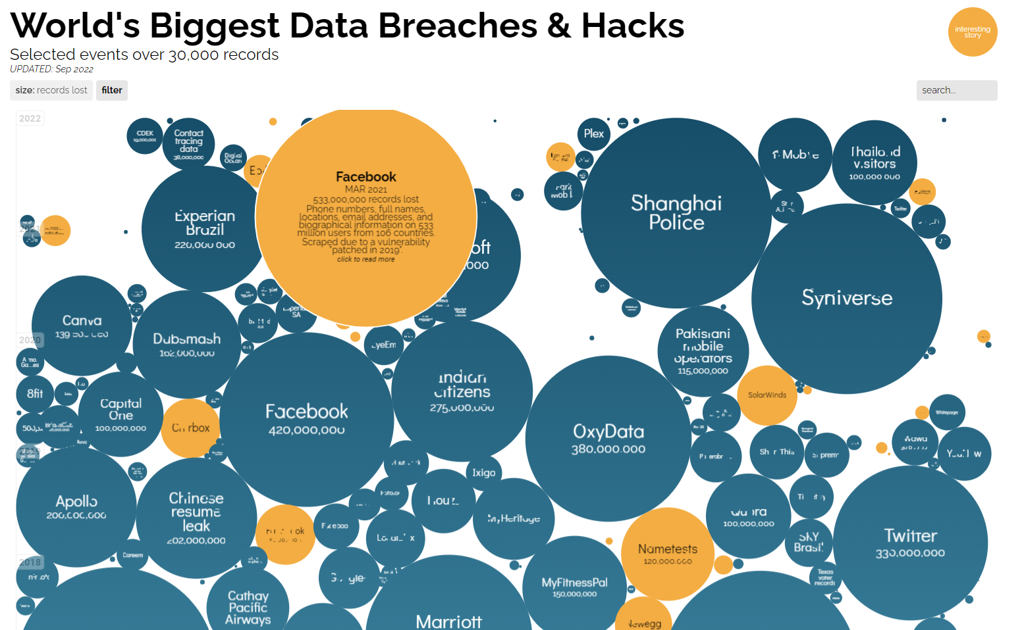
https://informationisbeautiful.net/visualizations/worlds-biggest-data-breaches-hacks/#bysensitivity
Notes:
https://informationisbeautiful.net/visualizations/worlds-biggest-data-breaches-hacks/#bysensitivity

Slide 24
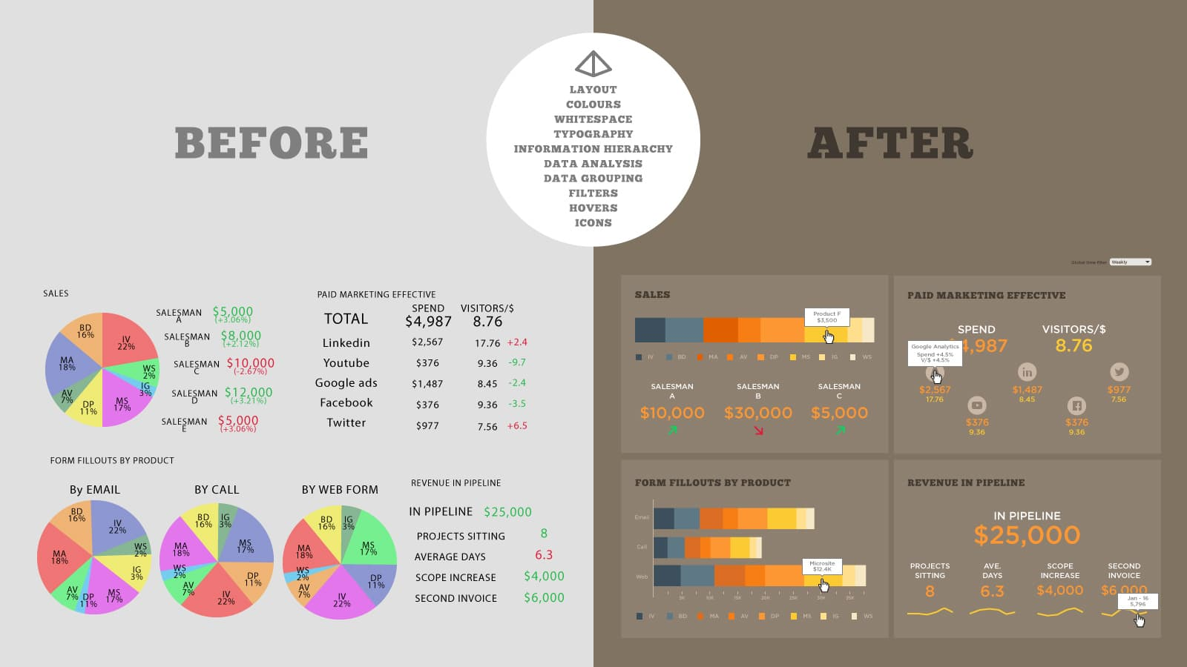
Infographic Makeovers
https://www.datalabsagency.com/2023/07/06/brand-guidelines-for-data/?v=7516fd43adaa
Notes:
https://www.datalabsagency.com/2023/07/06/brand-guidelines-for-data/?v=7516fd43adaa

Slide 25
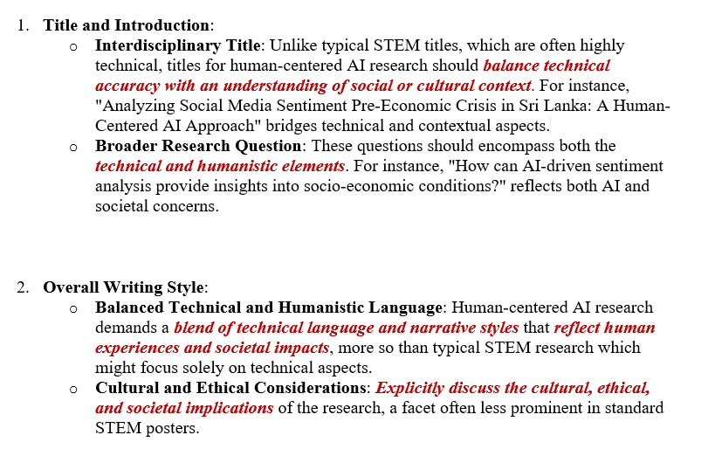
(i)
Human-
Centered AI
vs
STEM
Notes:
1. Title and Introduction:
o Interdisciplinary Title: Unlike typical STEM titles, which are often highly technical, titles for human-centered AI research should balance technical accuracy with an understanding of social or cultural context. For instance, "Analyzing Social Media Sentiment Pre-Economic Crisis in Sri Lanka: A Human-Centered AI Approach" bridges technical and contextual aspects.
o Broader Research Question: These questions should encompass both the technical and humanistic elements. For instance, "How can AI-driven sentiment analysis provide insights into socio-economic conditions?" reflects both AI and societal concerns.
2. Overall Writing Style:
o Balanced Technical and Humanistic Language: Human-centered AI research demands a blend of technical language and narrative styles that reflect human experiences and societal impacts, more so than typical STEM research which might focus solely on technical aspects.
o Cultural and Ethical Considerations: Explicitly discuss the cultural, ethical, and societal implications of the research, a facet often less prominent in standard STEM posters.
3. Organization and Layout:
o Interdisciplinary Sections: In addition to the standard sections (introduction, methods, results, conclusion), include sections on ethical considerations, societal impact, or cultural relevance.
o User-Centric Design: Design the poster with a focus on accessibility and inclusivity, reflecting the human-centered nature of the research.
4. Data Visualizations and Graphics:
o Inclusive and Diverse Visuals: Use visuals that are not only informative but also culturally sensitive and inclusive, considering the diverse audiences that human-centered AI research addresses.
o Representative Data Presentation: Ensure that data visualization reflects the diversity and complexity of human experiences, which is a unique aspect compared to more straightforward STEM data presentation.
5. Engagement and Interaction:
o Broader Engagement Questions: Pose questions that encourage viewers to think about both the technical and humanistic aspects of the research.
o Interactive Elements: Consider including interactive elements like QR codes linking to simulations or models, which can provide a deeper understanding of both the AI technology and its human-centered applications.
6. Presentation and Delivery:
o Interdisciplinary Summary Speech: Prepare a summary speech that not only explains the technical aspects but also addresses the human, cultural, and ethical dimensions of the research.
o Empathetic Communication: Emphasize a communication style that is not only clear and concise but also empathetic and inclusive, reflecting the human-centric nature of the research.

Slide 26
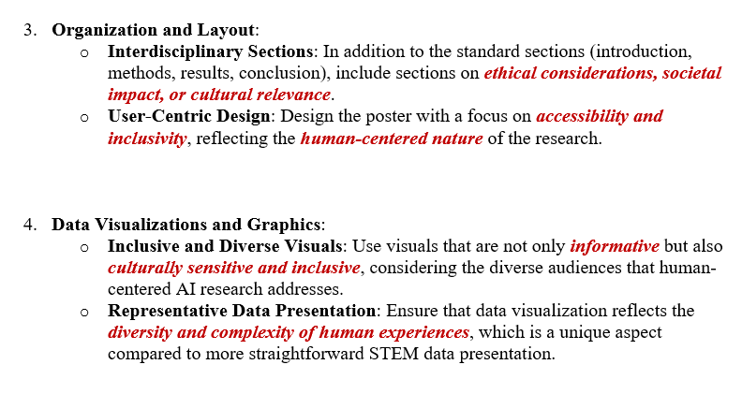
(ii)
Human-
Centered AI
vs
STEM
Notes:
1. Title and Introduction:
o Interdisciplinary Title: Unlike typical STEM titles, which are often highly technical, titles for human-centered AI research should balance technical accuracy with an understanding of social or cultural context. For instance, "Analyzing Social Media Sentiment Pre-Economic Crisis in Sri Lanka: A Human-Centered AI Approach" bridges technical and contextual aspects.
o Broader Research Question: These questions should encompass both the technical and humanistic elements. For instance, "How can AI-driven sentiment analysis provide insights into socio-economic conditions?" reflects both AI and societal concerns.
2. Overall Writing Style:
o Balanced Technical and Humanistic Language: Human-centered AI research demands a blend of technical language and narrative styles that reflect human experiences and societal impacts, more so than typical STEM research which might focus solely on technical aspects.
o Cultural and Ethical Considerations: Explicitly discuss the cultural, ethical, and societal implications of the research, a facet often less prominent in standard STEM posters.
3. Organization and Layout:
o Interdisciplinary Sections: In addition to the standard sections (introduction, methods, results, conclusion), include sections on ethical considerations, societal impact, or cultural relevance.
o User-Centric Design: Design the poster with a focus on accessibility and inclusivity, reflecting the human-centered nature of the research.
4. Data Visualizations and Graphics:
o Inclusive and Diverse Visuals: Use visuals that are not only informative but also culturally sensitive and inclusive, considering the diverse audiences that human-centered AI research addresses.
o Representative Data Presentation: Ensure that data visualization reflects the diversity and complexity of human experiences, which is a unique aspect compared to more straightforward STEM data presentation.
5. Engagement and Interaction:
o Broader Engagement Questions: Pose questions that encourage viewers to think about both the technical and humanistic aspects of the research.
o Interactive Elements: Consider including interactive elements like QR codes linking to simulations or models, which can provide a deeper understanding of both the AI technology and its human-centered applications.
6. Presentation and Delivery:
o Interdisciplinary Summary Speech: Prepare a summary speech that not only explains the technical aspects but also addresses the human, cultural, and ethical dimensions of the research.
o Empathetic Communication: Emphasize a communication style that is not only clear and concise but also empathetic and inclusive, reflecting the human-centric nature of the research.

Slide 27
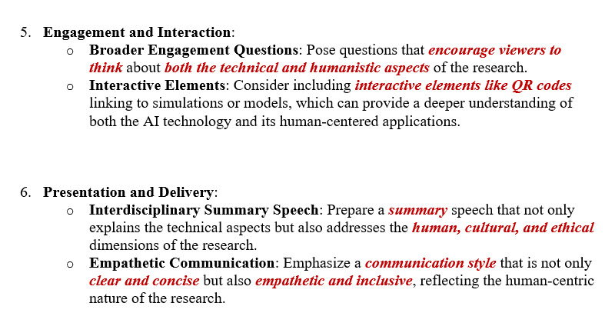
(iii)
Human-
Centered AI
vs
STEM
Notes:
1. Title and Introduction:
o Interdisciplinary Title: Unlike typical STEM titles, which are often highly technical, titles for human-centered AI research should balance technical accuracy with an understanding of social or cultural context. For instance, "Analyzing Social Media Sentiment Pre-Economic Crisis in Sri Lanka: A Human-Centered AI Approach" bridges technical and contextual aspects.
o Broader Research Question: These questions should encompass both the technical and humanistic elements. For instance, "How can AI-driven sentiment analysis provide insights into socio-economic conditions?" reflects both AI and societal concerns.
2. Overall Writing Style:
o Balanced Technical and Humanistic Language: Human-centered AI research demands a blend of technical language and narrative styles that reflect human experiences and societal impacts, more so than typical STEM research which might focus solely on technical aspects.
o Cultural and Ethical Considerations: Explicitly discuss the cultural, ethical, and societal implications of the research, a facet often less prominent in standard STEM posters.
3. Organization and Layout:
o Interdisciplinary Sections: In addition to the standard sections (introduction, methods, results, conclusion), include sections on ethical considerations, societal impact, or cultural relevance.
o User-Centric Design: Design the poster with a focus on accessibility and inclusivity, reflecting the human-centered nature of the research.
4. Data Visualizations and Graphics:
o Inclusive and Diverse Visuals: Use visuals that are not only informative but also culturally sensitive and inclusive, considering the diverse audiences that human-centered AI research addresses.
o Representative Data Presentation: Ensure that data visualization reflects the diversity and complexity of human experiences, which is a unique aspect compared to more straightforward STEM data presentation.
5. Engagement and Interaction:
o Broader Engagement Questions: Pose questions that encourage viewers to think about both the technical and humanistic aspects of the research.
o Interactive Elements: Consider including interactive elements like QR codes linking to simulations or models, which can provide a deeper understanding of both the AI technology and its human-centered applications.
6. Presentation and Delivery:
o Interdisciplinary Summary Speech: Prepare a summary speech that not only explains the technical aspects but also addresses the human, cultural, and ethical dimensions of the research.
o Empathetic Communication: Emphasize a communication style that is not only clear and concise but also empathetic and inclusive, reflecting the human-centric nature of the research.

Slide 28
Examples
Papers
Websites / Blogs
Plays
Films
Art Installations
Gallery Designs
Community Engagements
Independent Research
Internships / Jobs
Startups
Guest Speakers
Campus Roundtables

Slide 29
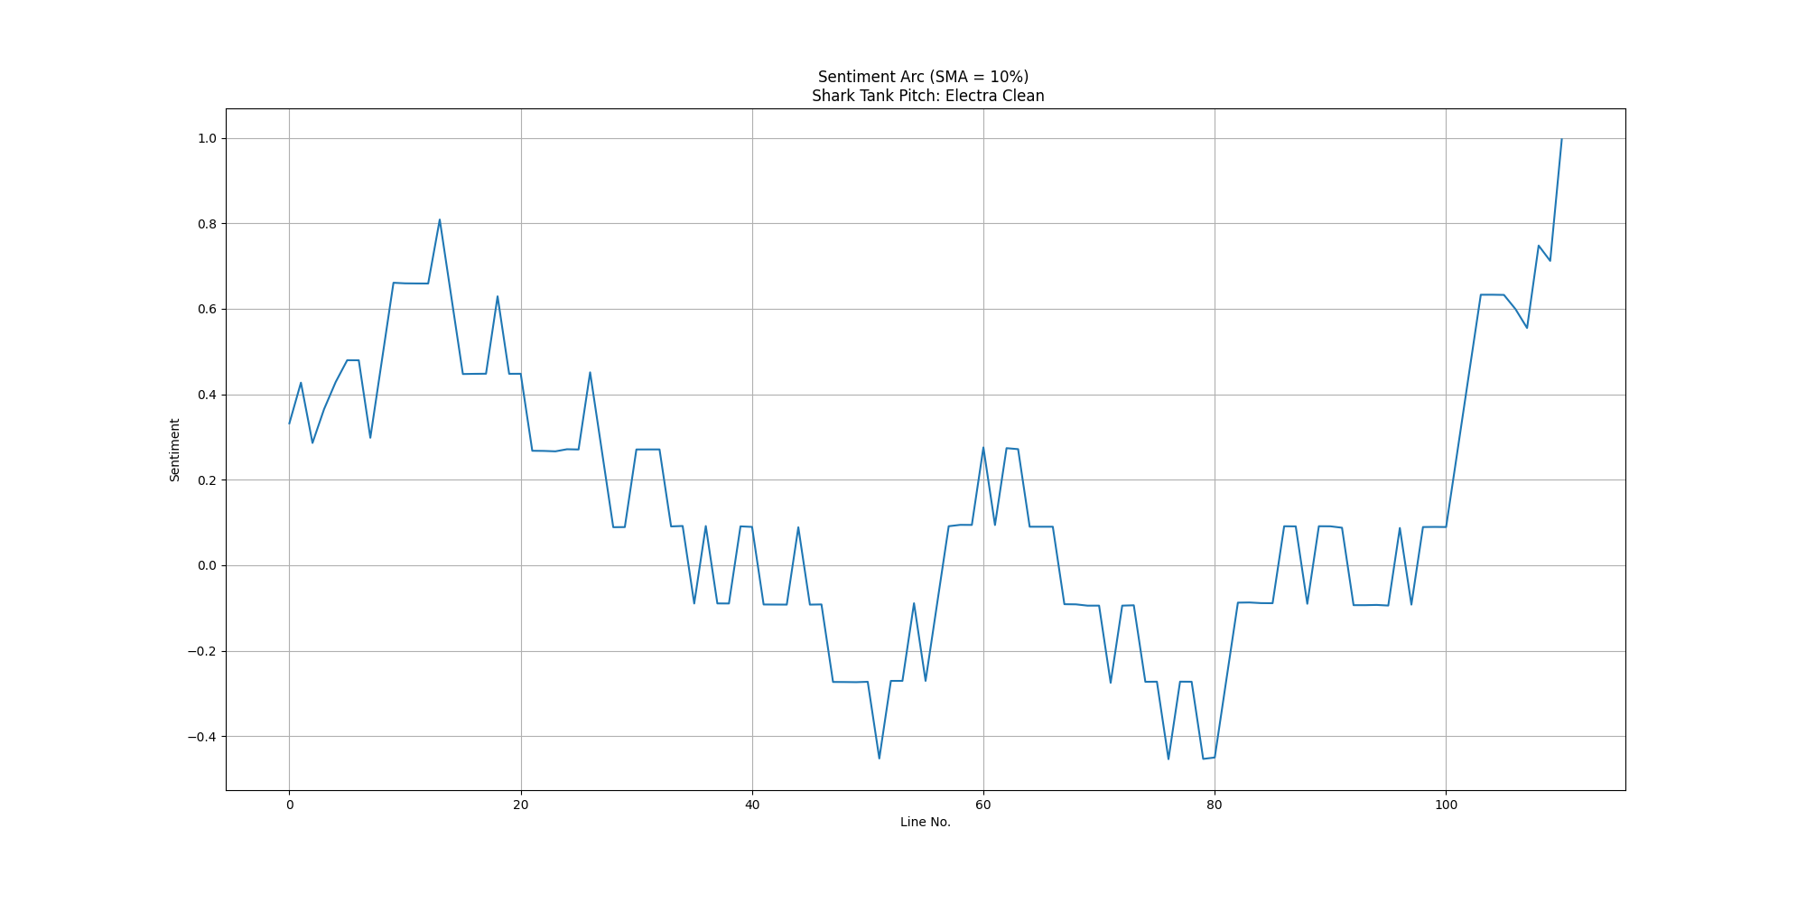
Shark Tank Pitch: Alexander Gow

Slide 30
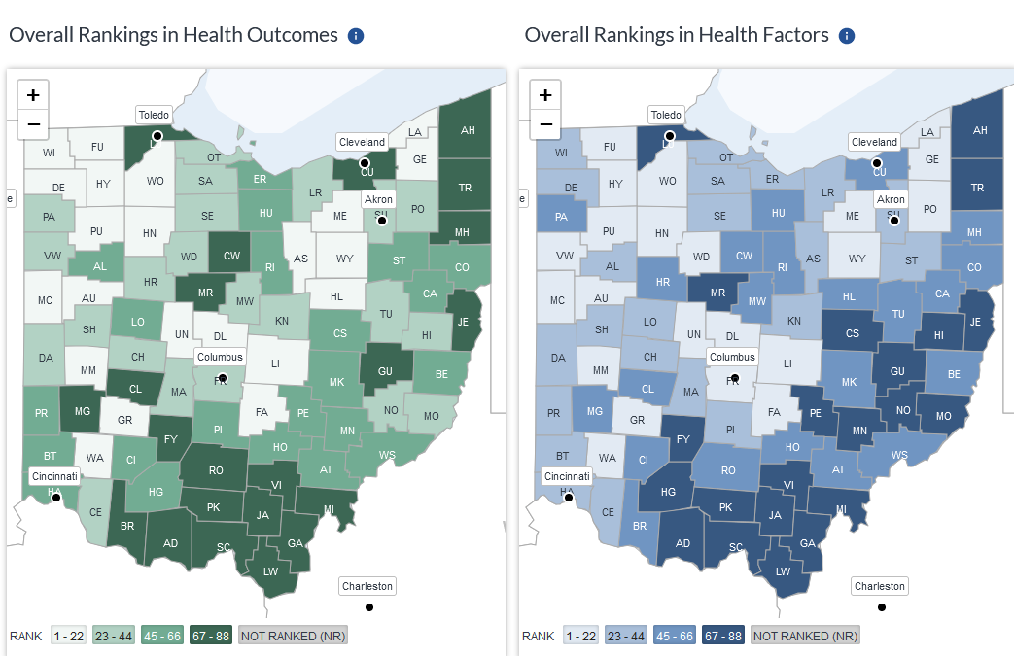
Ohio Opioid Crisis: Zach Elsawy

Slide 31
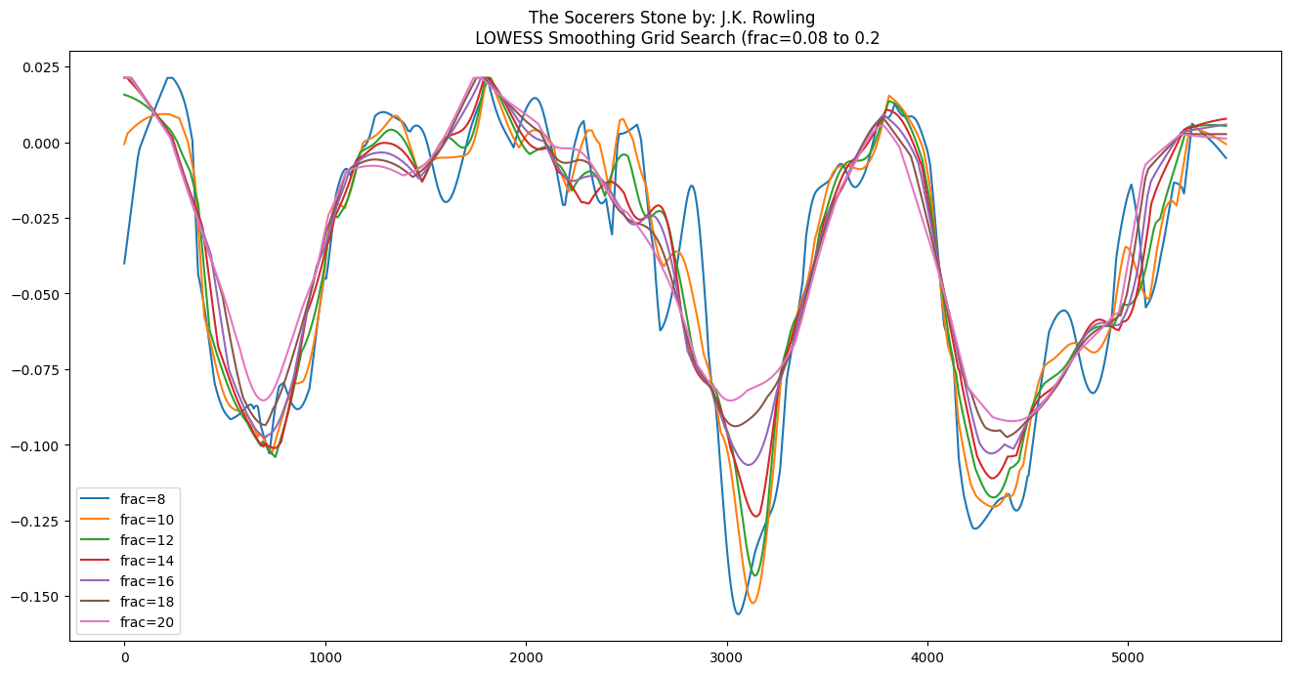
Harry Potter Screen Adaptations: Erin Shaeen

Slide 32
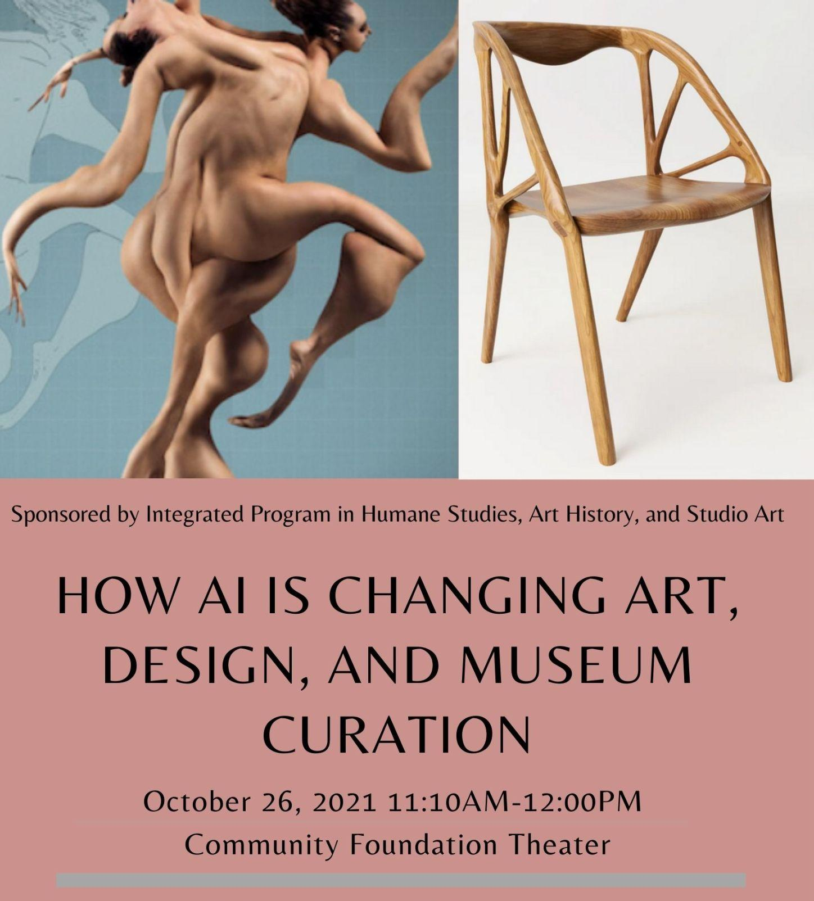
Generative AI Art & Design: Jill Noorily

Slide 33
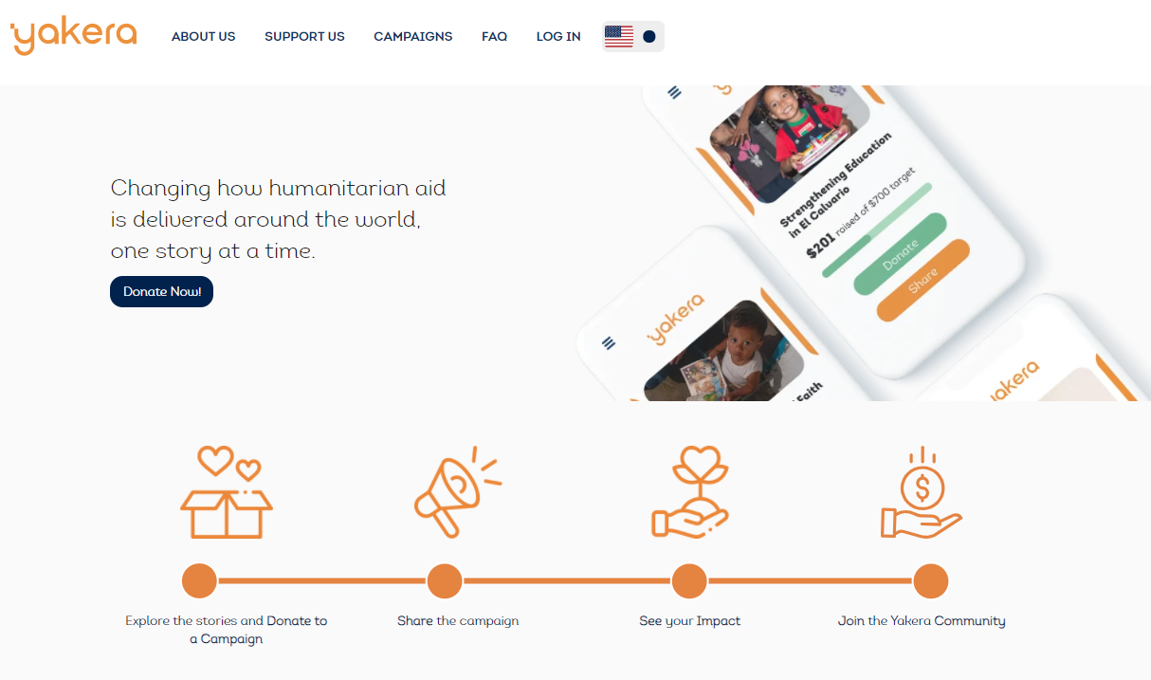
Yakera: Raul Romero & Tomas Munoz Reyes

Slide 34
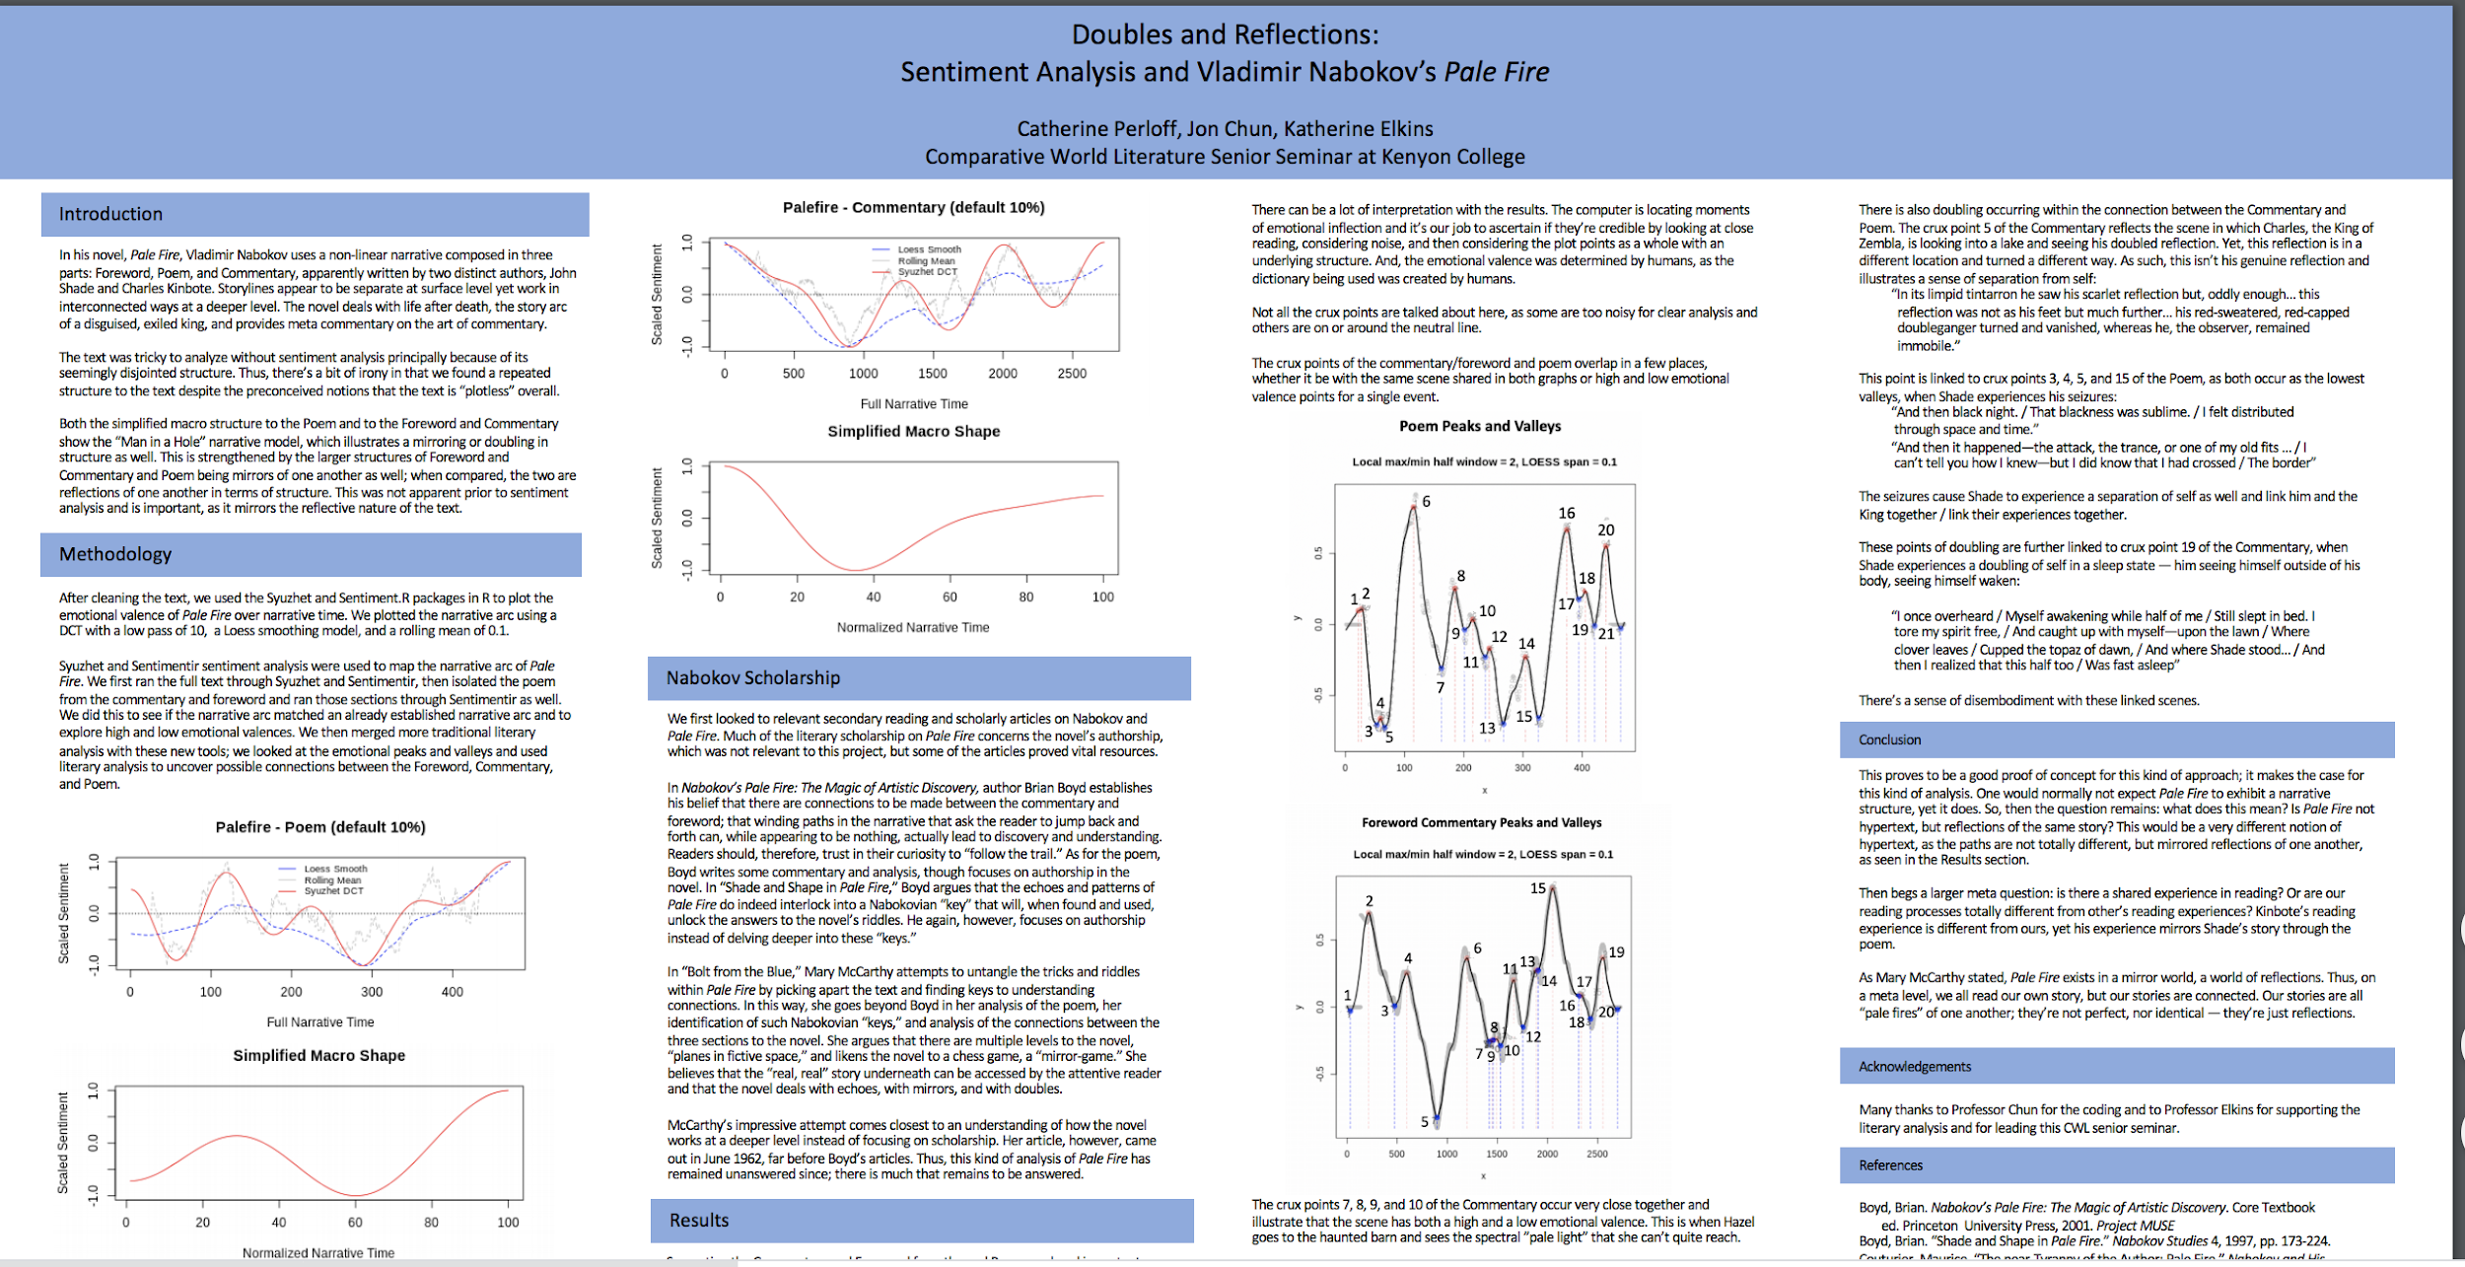

Slide 35
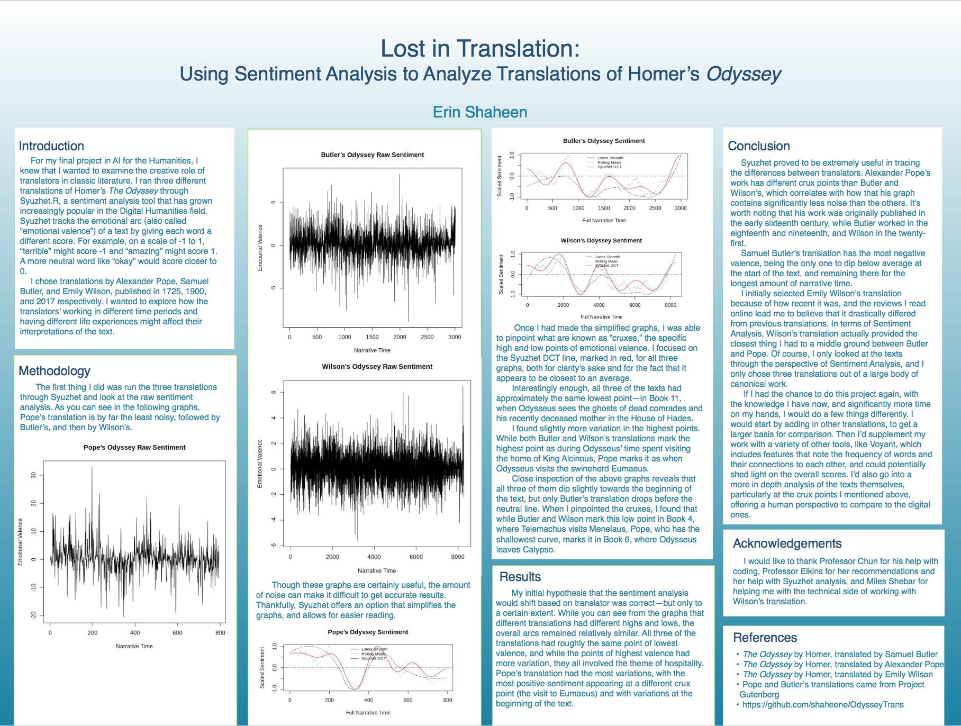

Slide 36

Notes:
https://public.tableau.com/app/profile/lara.knopf/viz/Environmentalimpactoffood/Story1?publish=yes

Slide 37
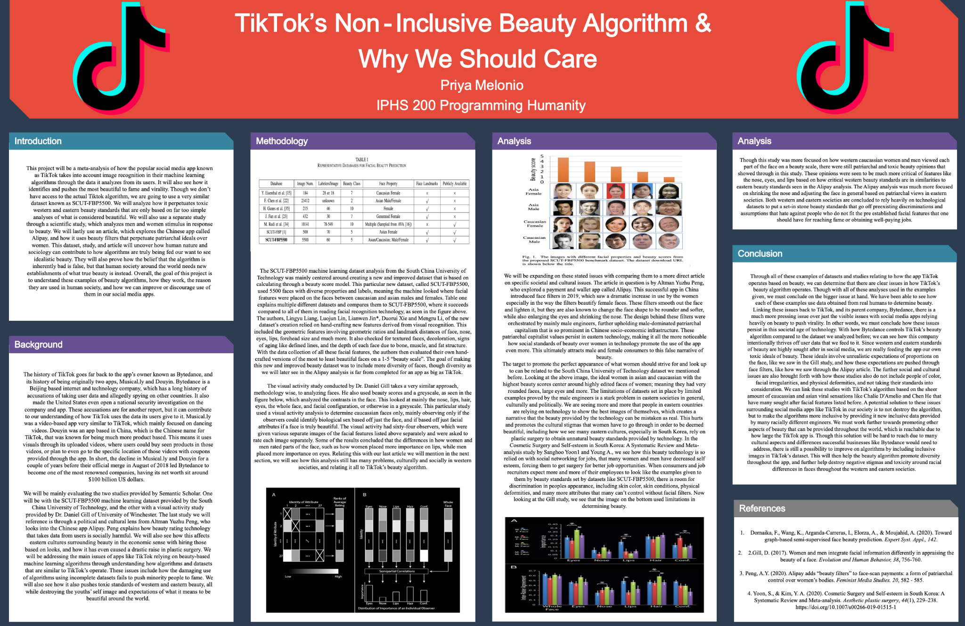
Notes:
https://public.tableau.com/app/profile/lara.knopf/viz/Environmentalimpactoffood/Story1?publish=yes

Slide 38
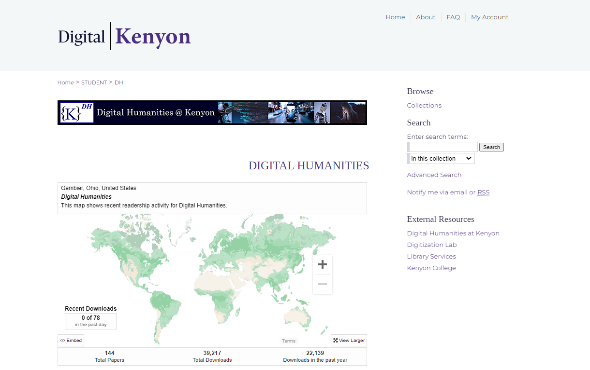
digital.kenyon.edu/dh/
Notes:
https://public.tableau.com/app/profile/lara.knopf/viz/Environmentalimpactoffood/Story1?publish=yes

Slide 39
Fin

